Slide 1
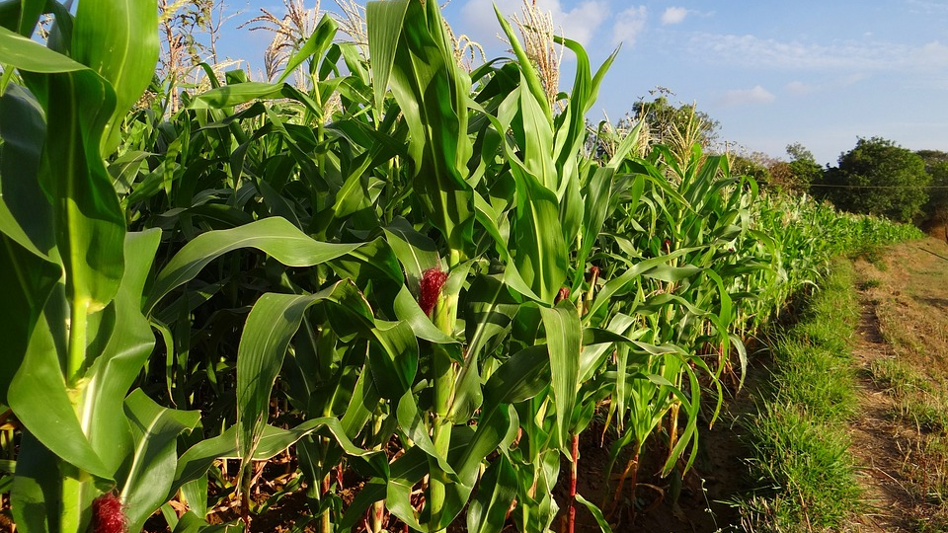
CROP RECOMMENDATION SYSTEM
UNDER THE GUIDANCE OF MS. TABEER MAM

Slide 2
Team
SHARIKA MUSHTAQ(180314)
BASIT ASLAM(180343)
ABRAR AHMED(180357)

Slide 3
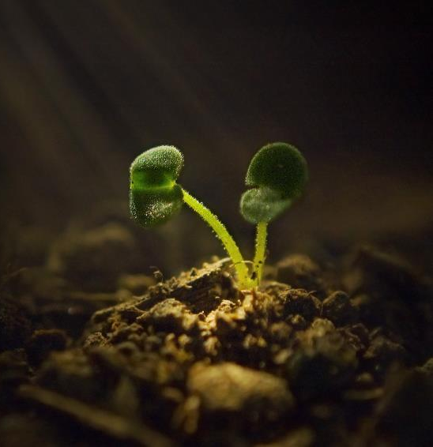
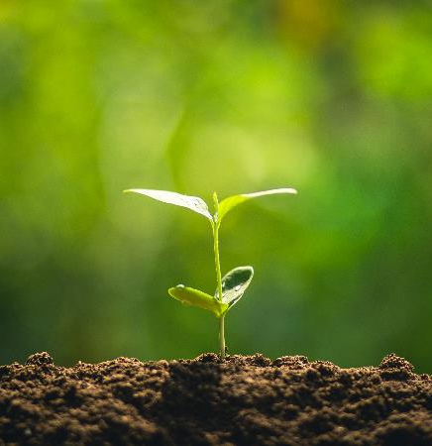
CONTENTS
Introduction
Problem Definition
Proposed Methodology
Dataset Used
Architecture
Models Used
Implementation(Screenshot)
Conclusion And Future scope

Slide 4
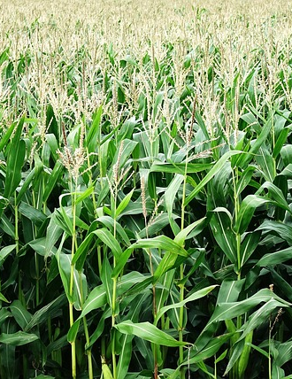
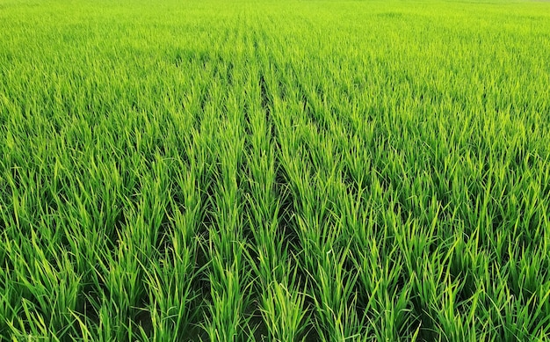
INTRODUCTION
The Indian population is highly dependent on agriculture.
The agriculture sector plays a vital role in the economic growth of country.
Some of the challenges the farmers face are-
Dealing with climatic changes.
Nutrient deficiency in the soil.
Farmers make a mistake by cultivating the same crops every year.
Our project aims to discover the best model for crop prediction, which can help farmers decide the type of crop to grow based on the climatic conditions and nutrients present in the soil which helps in increasing crop yeild and gaining profits.

Slide 5
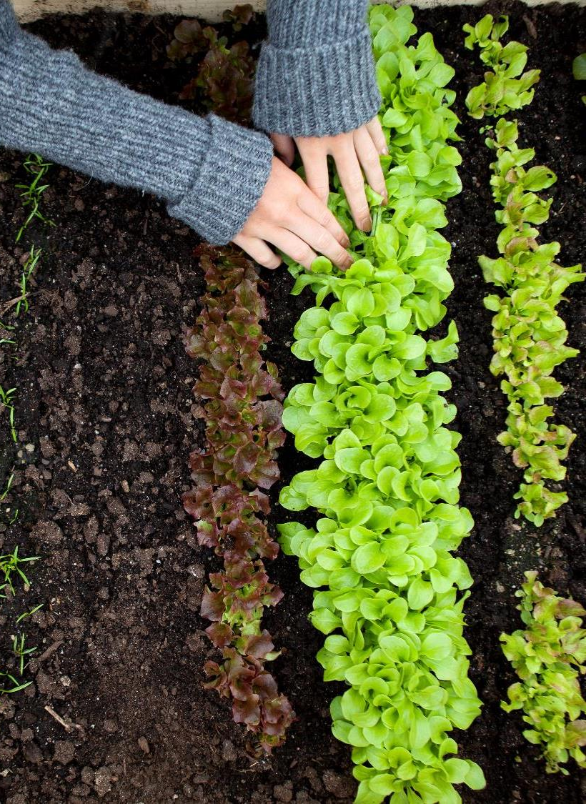
PROBLEM FORMULATION
Need of Increase In Productivity
Not Able To Choose Right Crop Based On Their Soil Requirements

Slide 6
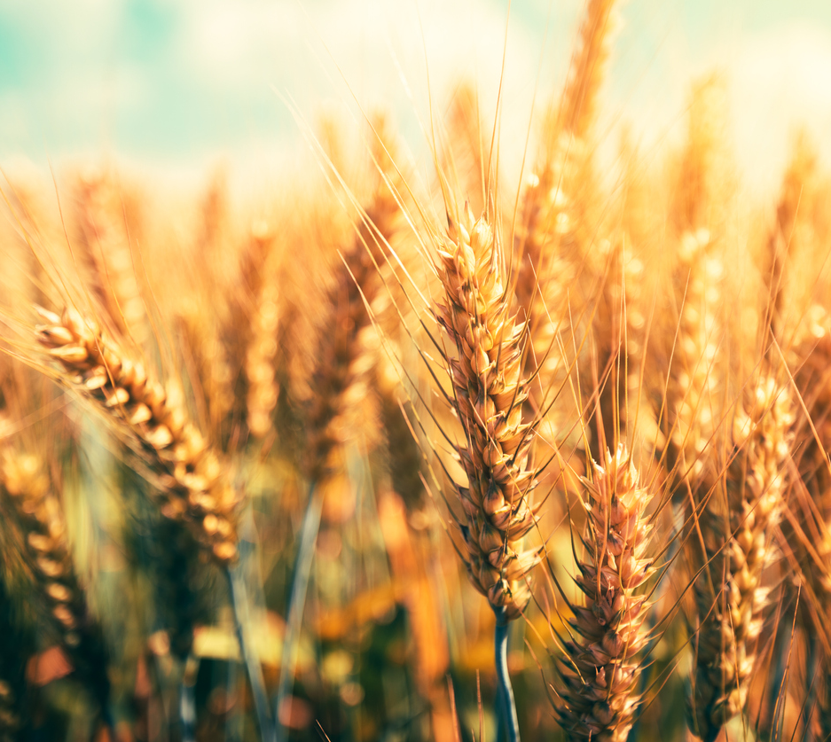
PROPOSED METHODOLOGY
To Implement Precision Agriculture
Design A Web Application

Slide 7
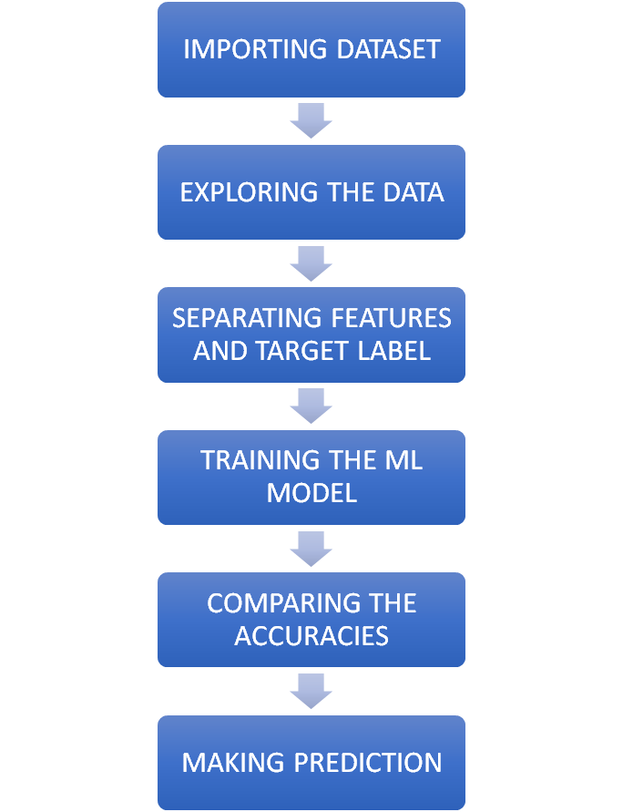
WORKFLOW OF
OUR PROPOSED MODEL

Slide 8
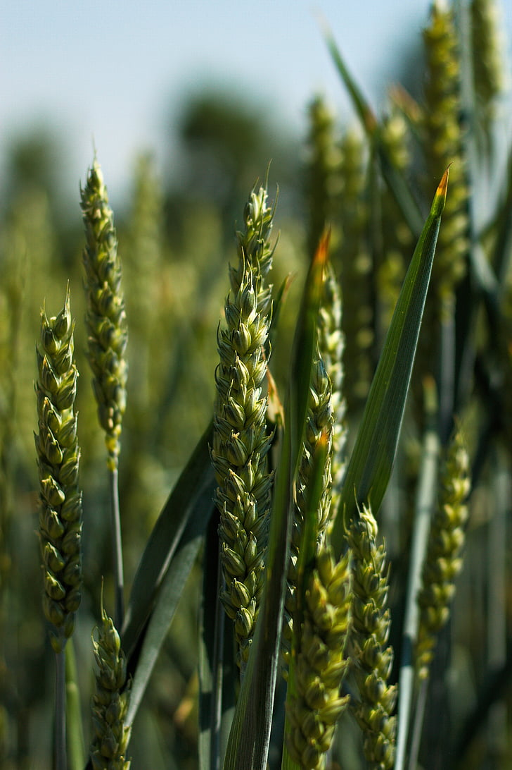
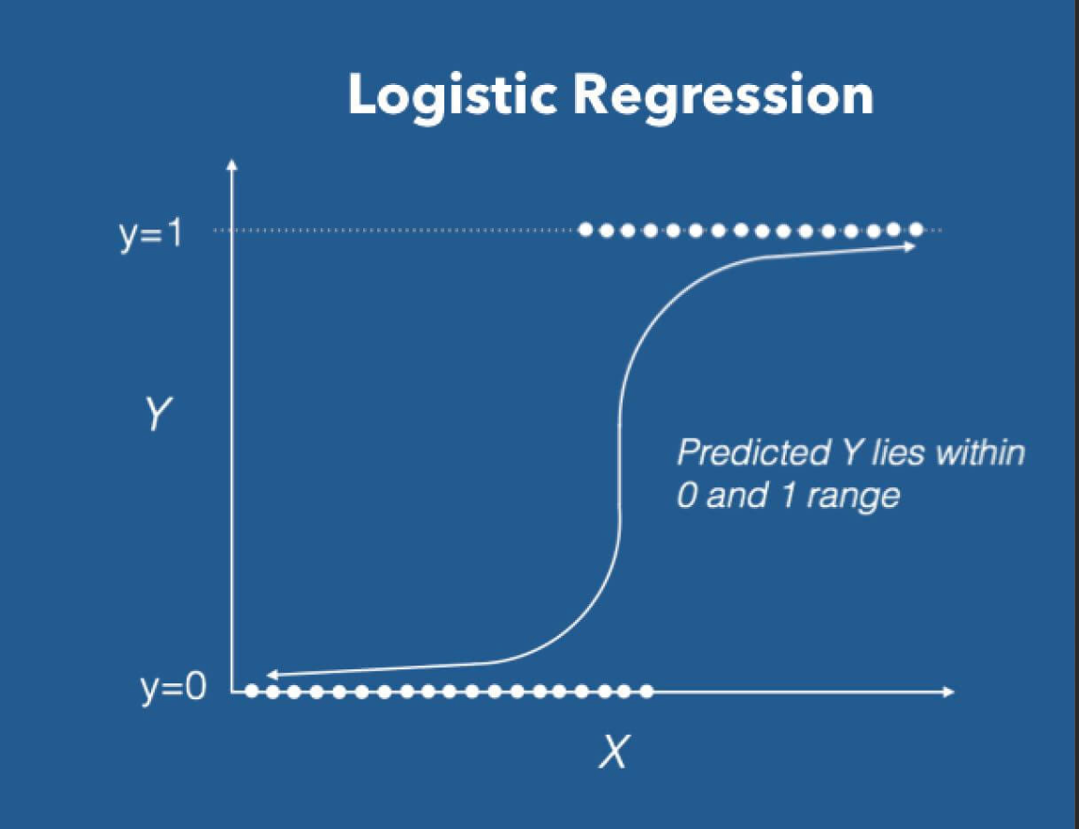
LOGISTIC REGRESSION

Slide 9
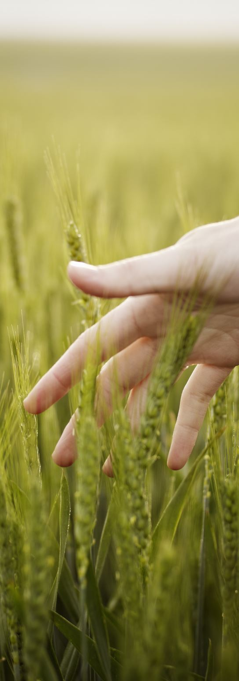
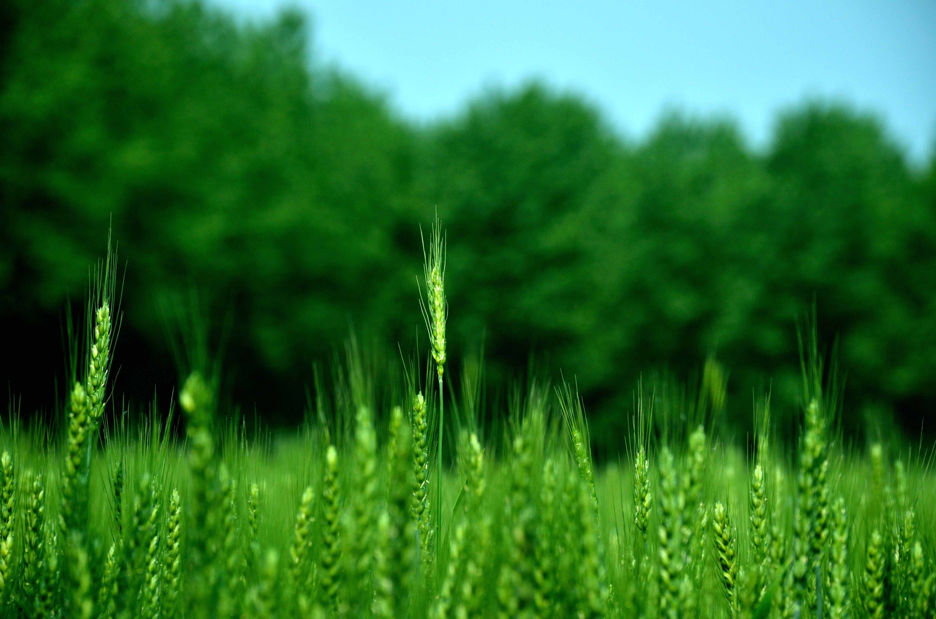

SUPPORT VECTOR MACHINE

Slide 10
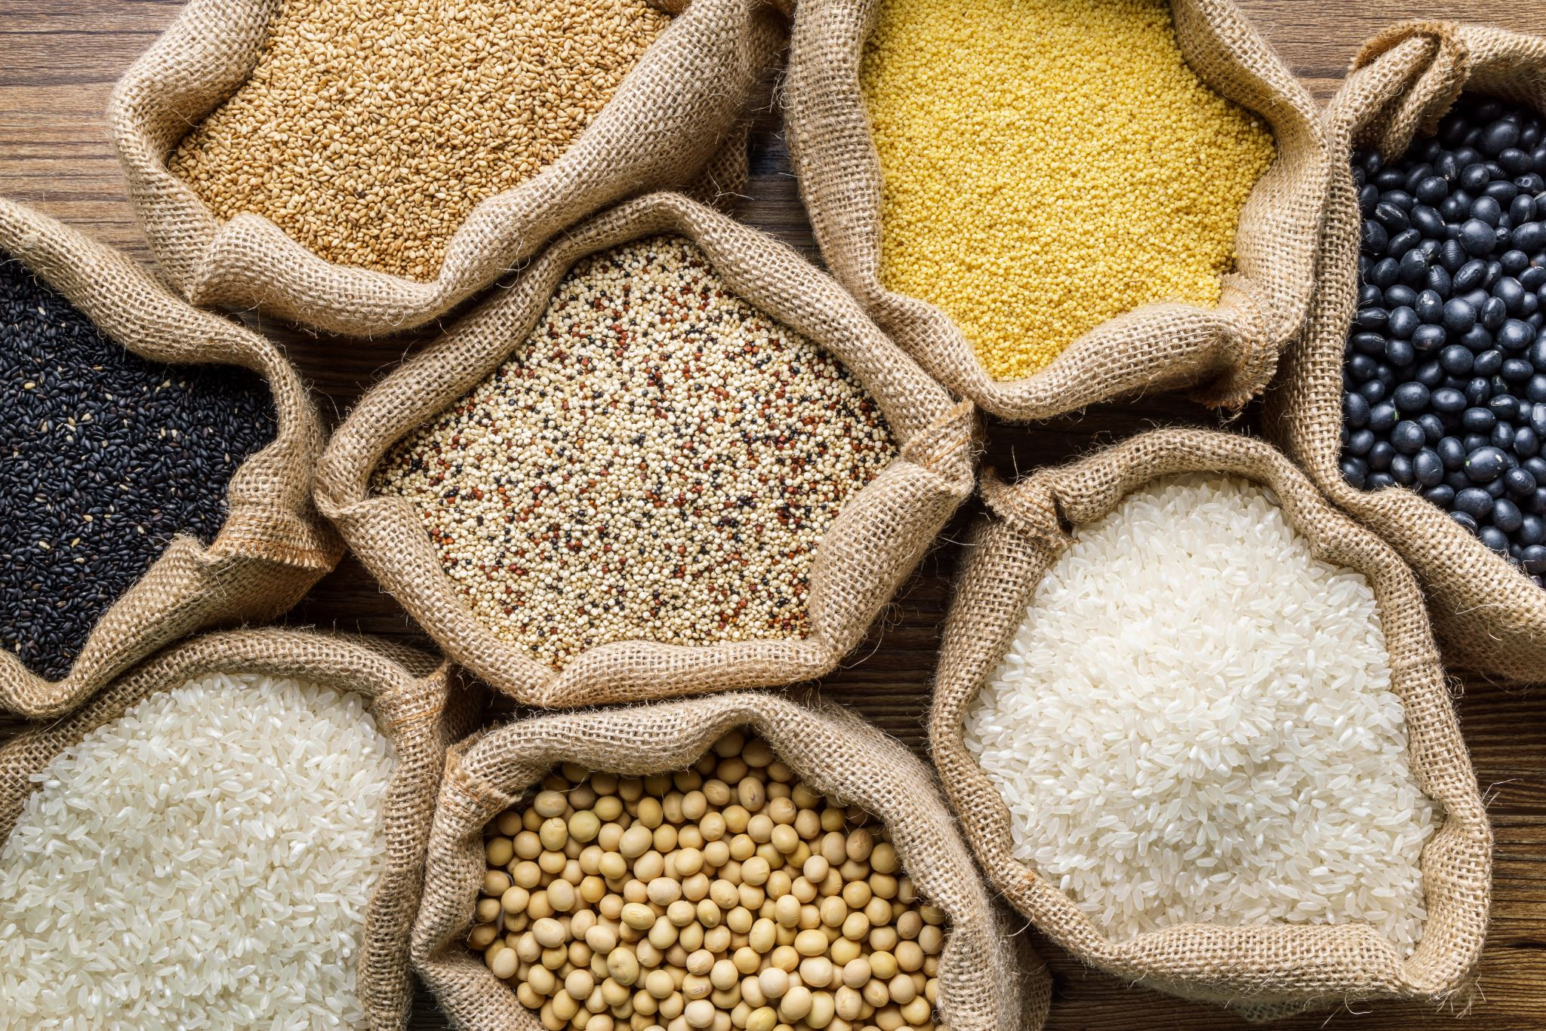
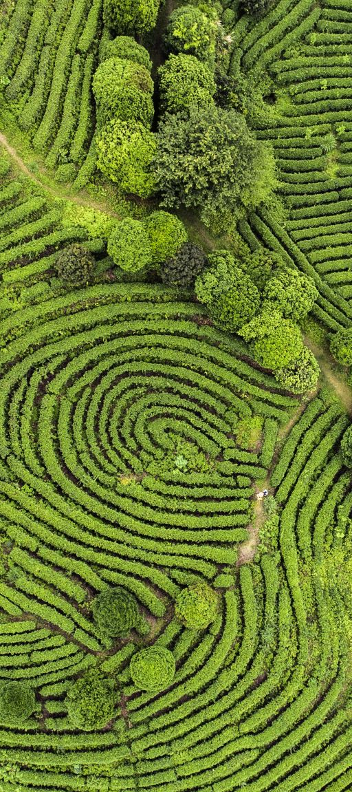
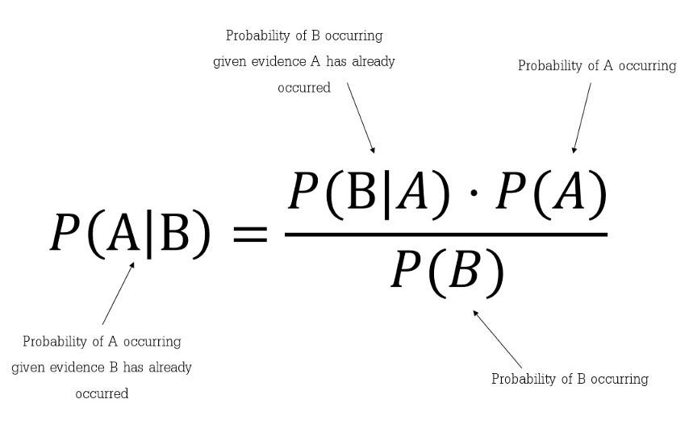
NAIVE BAYES

Slide 11
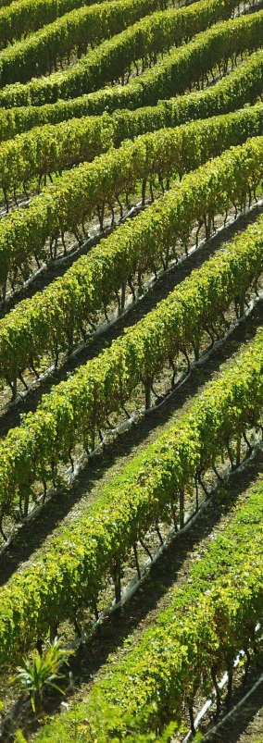
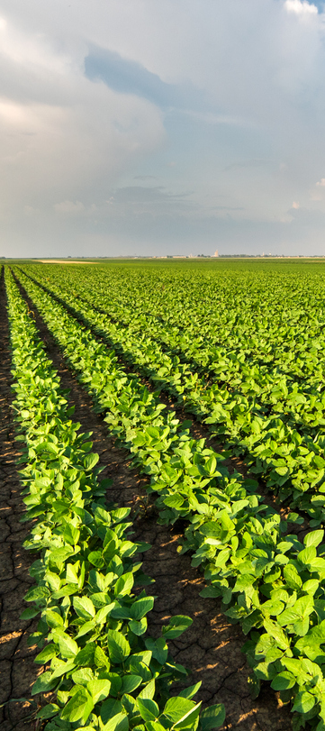
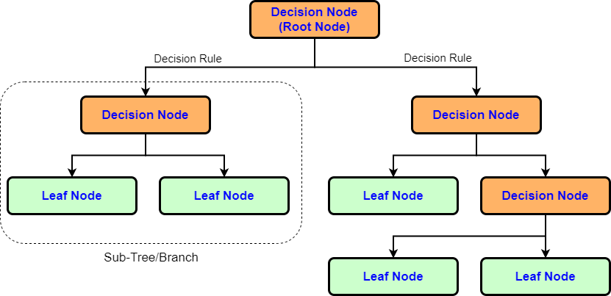
DECISION TREE
This Photo by Unknown author is licensed under CC BY-NC-ND.

Slide 12
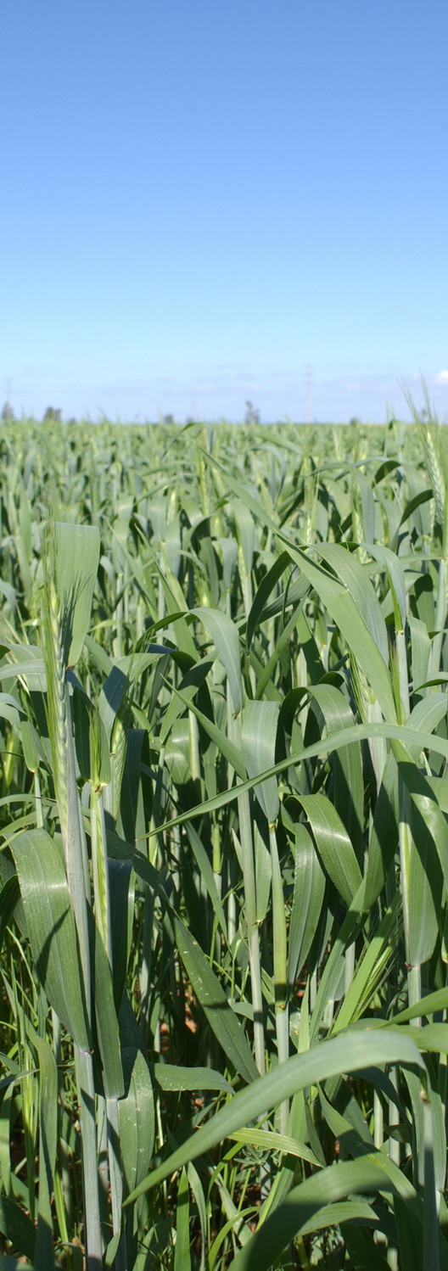
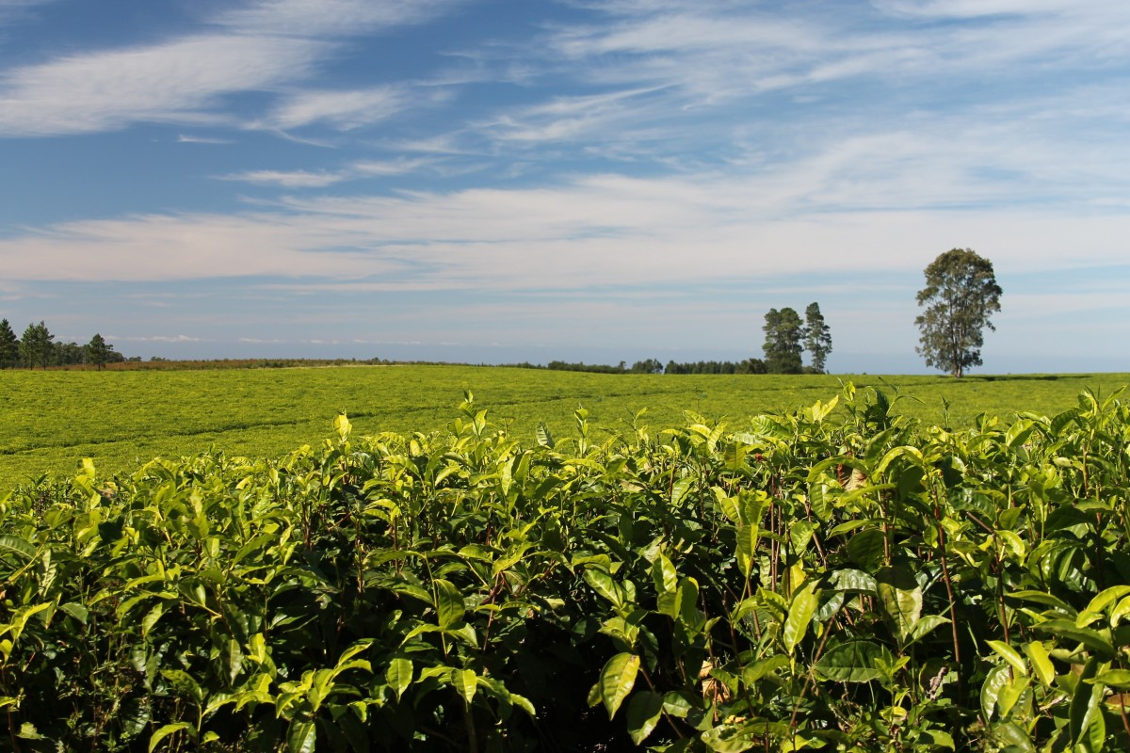
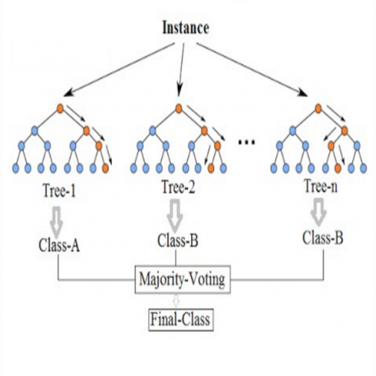
RANDOM FOREST

Slide 13
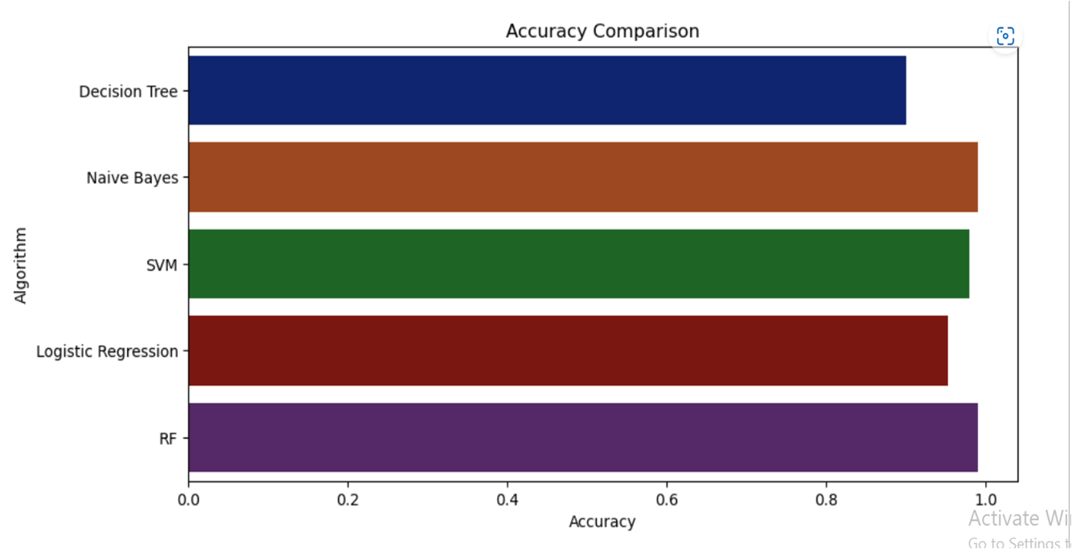
ACCURACY ANALYSIS

Slide 14
ACCURACY COMPARISION
Decision Trees : 90.0
Naive Bayes : 0.990909090909091
SVM : 0.9795454545454545
Logistic Regression:0.9522727272727273
RF : 0.990909090909091

Slide 15
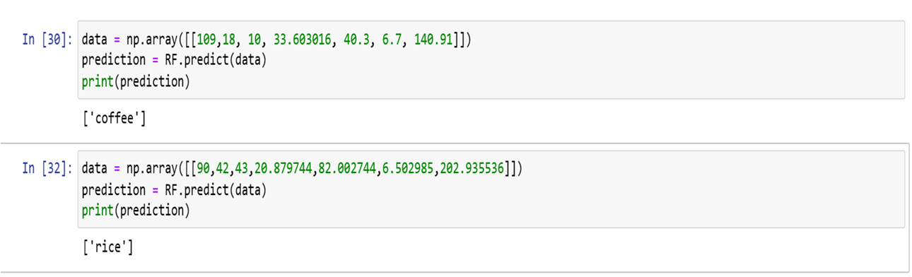
MAKING PREDICTION

Slide 16
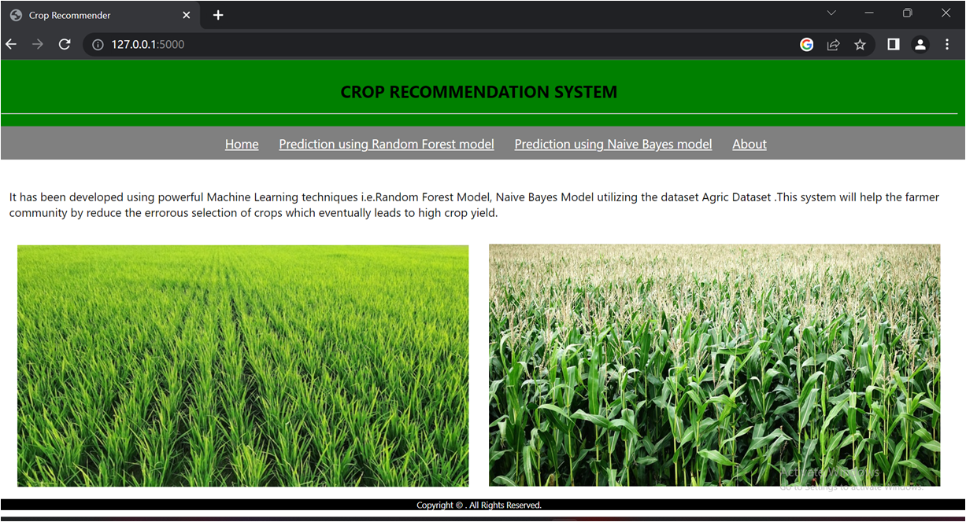
DEPLOYMENT

Slide 17
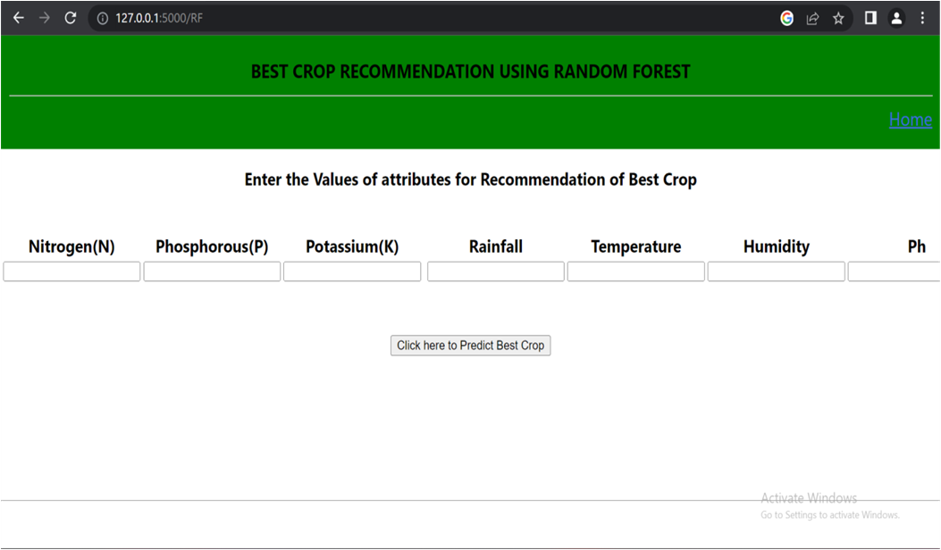

Slide 18
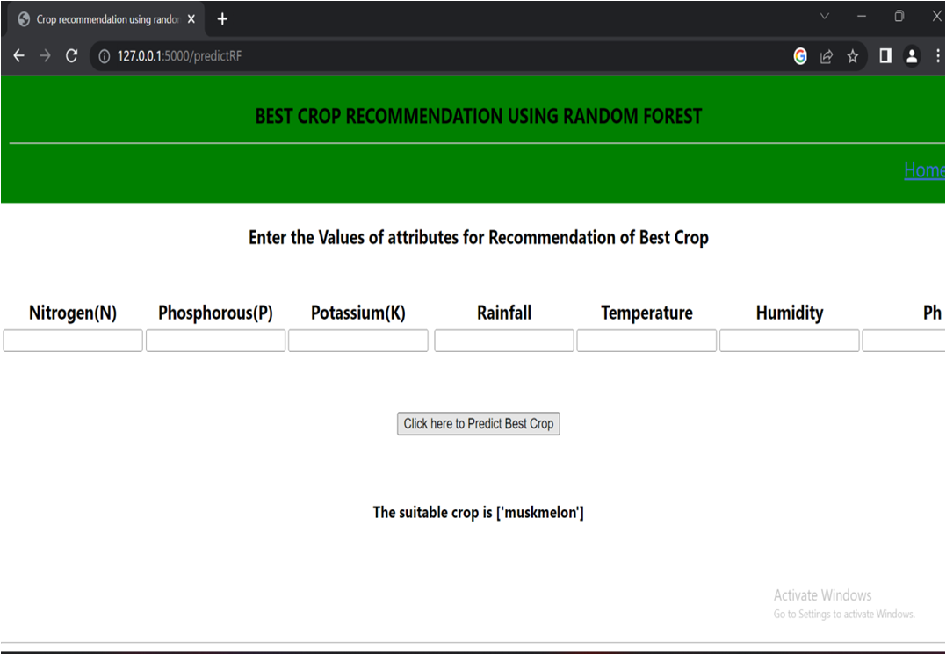

Slide 19
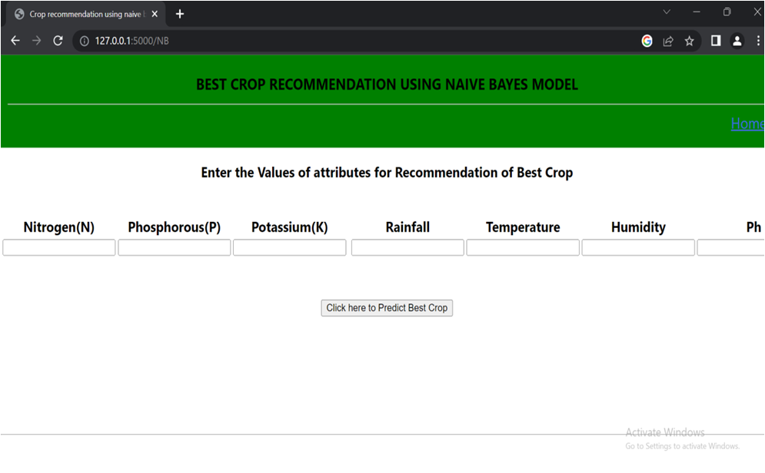

Slide 20
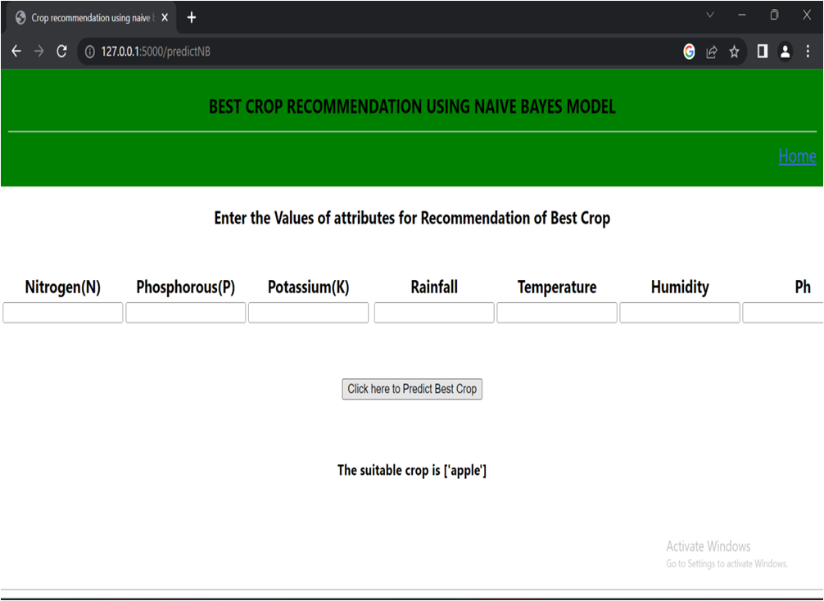

Slide 21
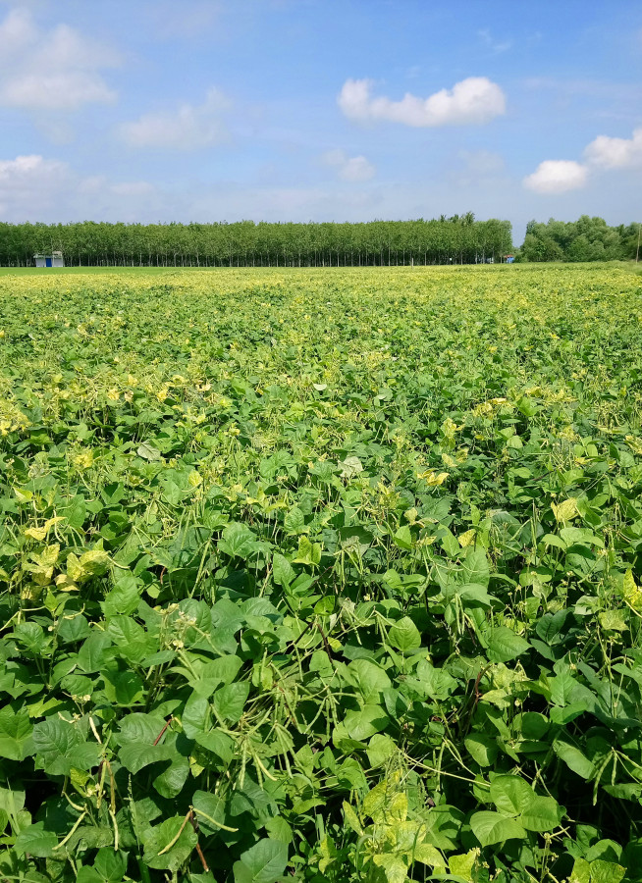
CONCLUSION
Benefit farmers to maximize productivity in agriculture
Recommend right crops based on soil parameters and environmental conditions and that too with high accuracy.
This project the farmers can save time as well as capital

Slide 22
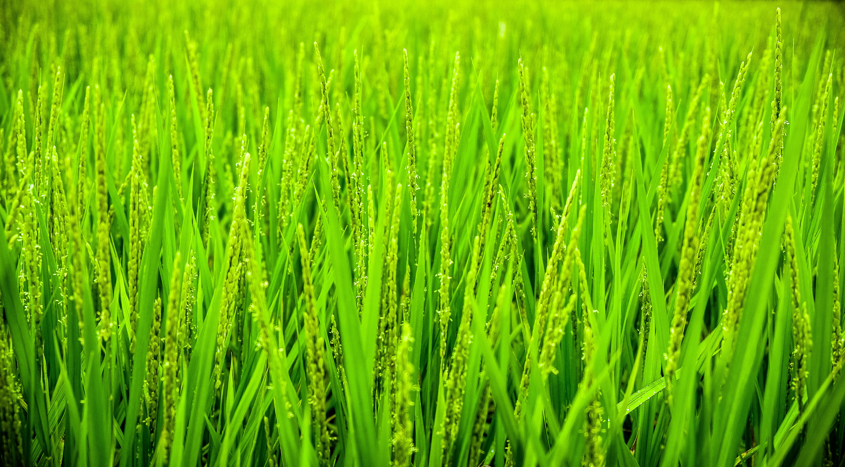
FUTURE SCOPE
It currently supports 22 crops, more crops can be added.
In Crop Recommendation, values are manually entered by user of temperature, humidity, rainfall. we can also use some weather API to fetch the real time parameters by the city and state.
This project can be further expanded for fertilizer and pesticide recommendation.
Add chatbot to help farmers.

Slide 23
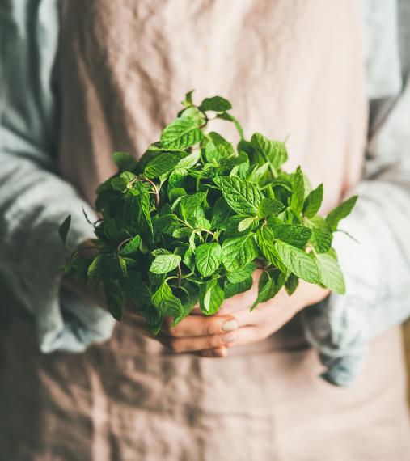
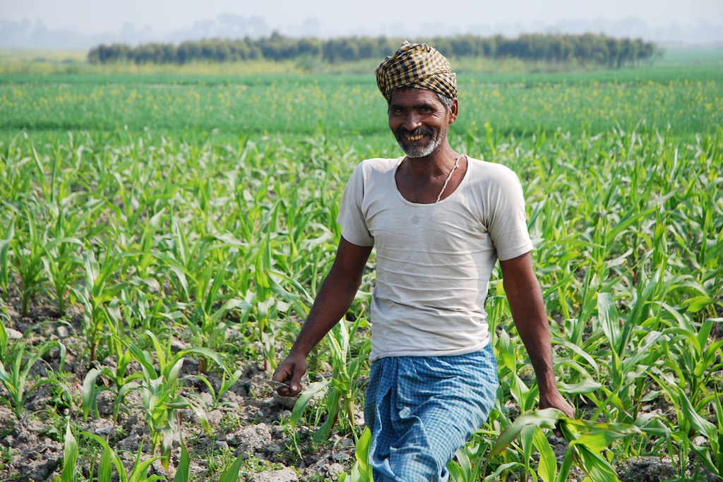
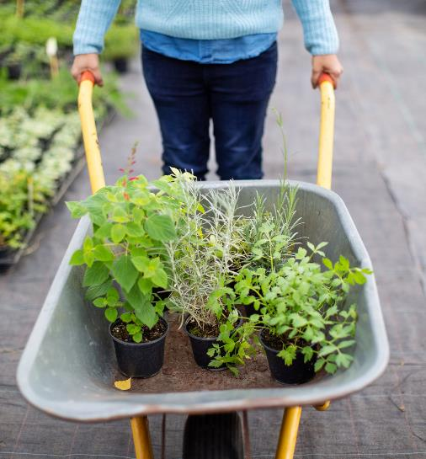

THANK YOU
This Photo by Unknown author is licensed under CC BY-SA-NC.

